Slide 1


Department of Electrical and Electronics Engineering
Carbon Emissions Calculator
Course: ECE (AIML - B)
By
Janvi Bajpai 1032233180

Slide 2

Why this project matters?
Buildings = ~40% of global CO₂ emissions Existing tools → Focus on lifestyle (travel, food), ignore buildings
India’s need → Simple, building-focused, climate-adaptive tool
Our Edge → From Numbers ➝ To Action (Green Score + Smart Suggestions)
2
DoEEE

Slide 3
Visions & Objectives
Vision: Empower communities to measure, understand & reduce building emissions
Objectives:
Easy-to-use web app
Personalized solutions for each building type
Gamified awareness via Green Score & badges
Scalable to campuses, cities, governments
School of Electronics and Communication Engineering

Slide 4
What makes us different (proposed system)
Tailored Strategies → Building + climate-zone based tips (e.g., insulation for cold, solar shading for hot).
What-If Scenarios → Test upgrades like LEDs, solar, insulation & see instant CO₂ + cost savings.
Localized Carbon Oﬀset → Suggest nearby plantation drives & renewable projects for direct community impact.
Green Score + Leaderboard → Buildings ranked Bronze , Silver , Gold ; motivates healthy competition.
Community Sharing → Generate & share Green Score cards on portals/social media to inspire others.
School of Electronics and Communication Engineering

Slide 5
How it works:
Input – User enters floor area, occupancy, workdays, and climate zone.
Carbon Model – Calculates annual emissions using energy factors + climate multipliers.
Green Score – Rates the building (0–100) and benchmarks it against similar ones.
Smart Suggestions – Provides tailored solutions: LEDs, insulation, solar, ventilation, etc.
Leaderboard & Sharing – Compare scores, earn eco-badges, and share results online.
School of Electronics and Communication Engineering

Slide 6
The impact we expect
Web-based Carbon Calculator → for buildings & campuses
“What-If” Analysis → test upgrades, make smarter choices
Gamiﬁed Green Score → awareness through fun & competition
Customized for Indian Climate Zones →
locally relevant results
Scalable Solution → from colleges to offices & smart cities

Slide 7
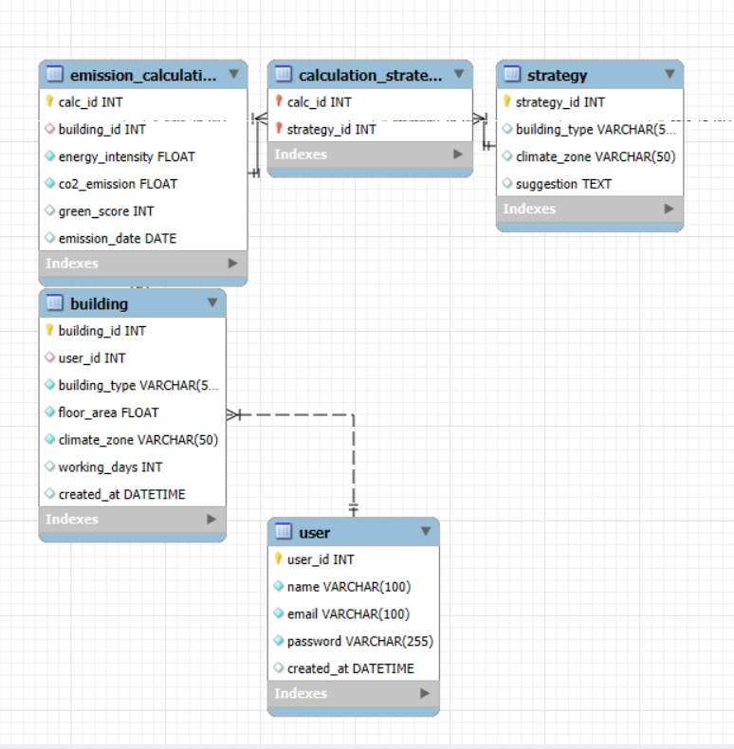
Entity Relation Diagram

Slide 8
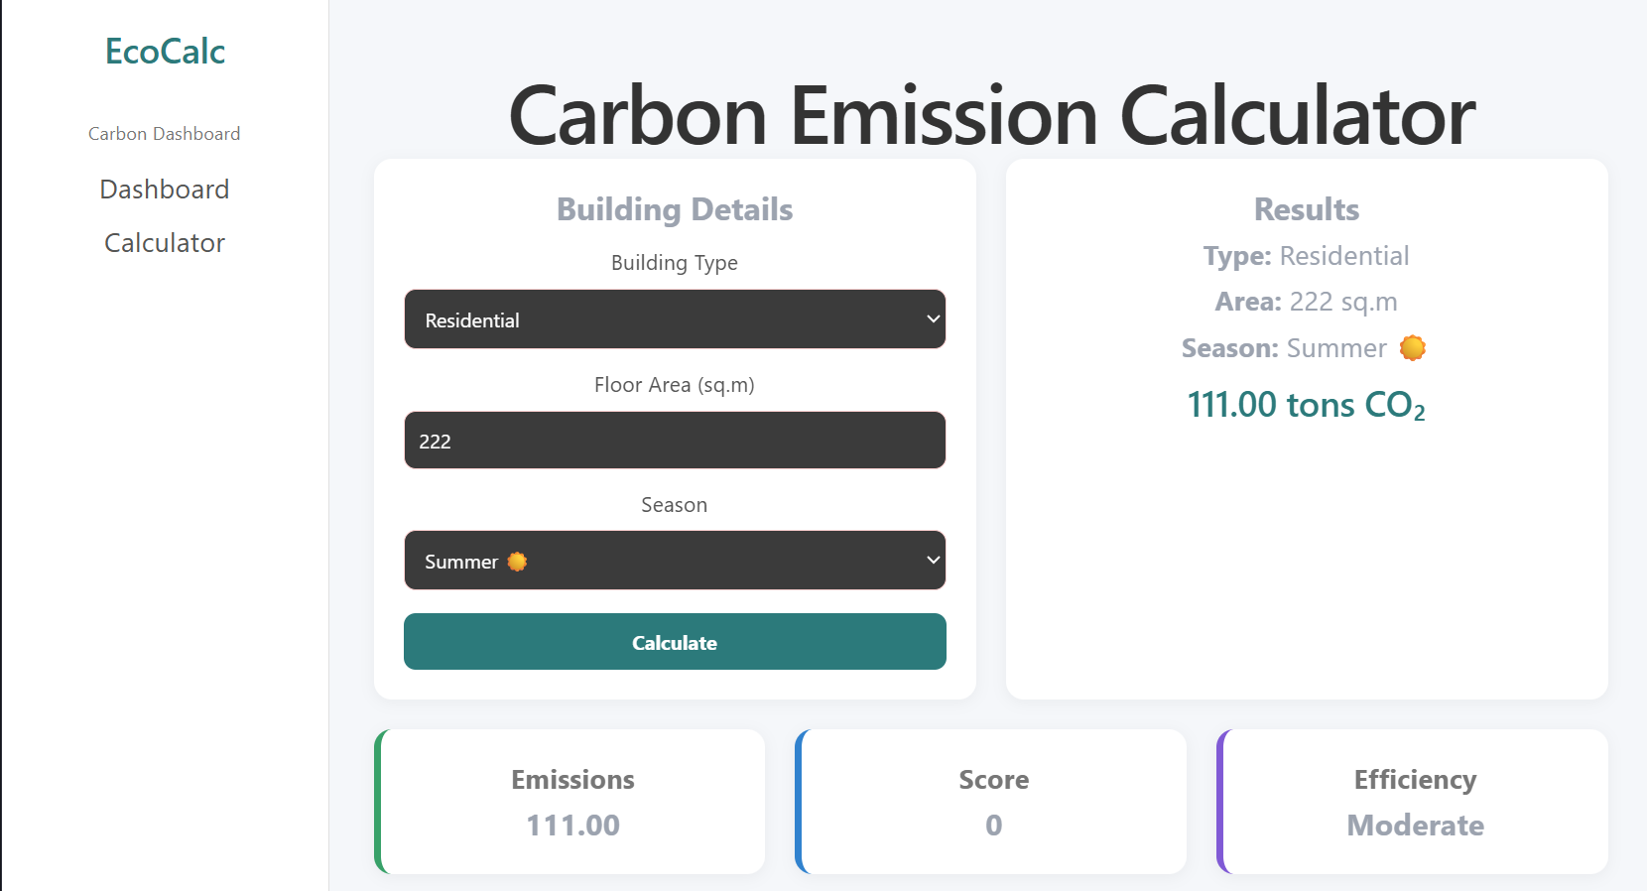
EcoCalc – Emission Calculator

Slide 9
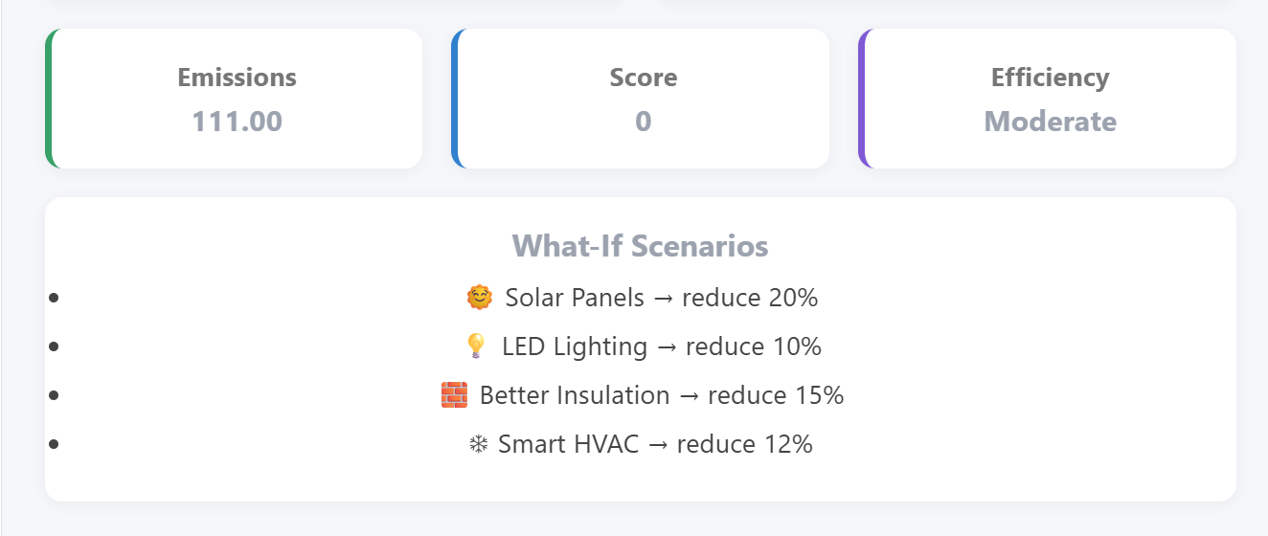
EcoCalc – Emission Calculator

Slide 10
Tech Stack
Layer | Technology | Purpose
Frontend Framework | React.js | Builds interactive UI (dashboard, forms, results)
Language | TypeScript (TSX) | Type-safe frontend development
Styling | Tailwind CSS | Modern UI, responsive dashboard design
Build Tool | Vite | Fast development server & bundling
State Management | React Hooks (useState) | Manage form data & results
Backend Runtime | Node.js | Runs server-side logic
Backend Framework | Express.js | Handles APIs and routing
Database | SQLite3 | Stores data locally (lightweight DB)
API Communication | REST APIs | Connect frontend ↔ backend
CORS Handling | cors (npm package) | Allows frontend-backend communication
Version Control | Git + GitHub | Code hosting and collaboration
Deployment (Frontend) | Render | Hosting React app
Deployment (Backend) | Render | Hosting Node + Express server

Slide 11
THANK YOU

